Slide 1

iSchool Careers Newsletter
Information Challenge 2022
Yuanqi (Kinny) Chen & Zi Lin
2nd-Year HCIM Master’s Students

Slide 2
Agenda
Design Challenge Overview
Process Overview
Provisional Personas
User Interviews
Problem Statement
Prototype
User Testing
Limitation & Opportunities

Slide 3
Design Challenge Overview
iSchool Careers is a career service provided for current students and alumni of College of Information Studies (iSchool) at the University of Maryland, College Park. iSchool Careers’ current services include drop-in career consultation and a weekly newsletter with various career-related resources.
The current iSchool Careers Newsletter is very simple in its content and layout, so it needs to be redesigned to improve in both areas.

Slide 4
Process Overview
Empathize
Define
Ideate
Prototype
Test
Kickoff meeting
Expert interviews
Provisional personas
User interviews
Affinity map
Problem statement
Competitive research
Sketch
Wireframes
Hi-fi prototypes
User tests
Feedback
Design Refinement
Notes:
Provisional personas -> interview questions -> user interview -> affinity mapping -> competitive research -> sketch -> wireframe -> prototype -> test & feedback

Slide 5
Provisional Personas
The Job Seeker
The Explorer
Characteristics
They know what kind of jobs they want. They’re actively looking & applying for internships / jobs.
Goals
Get an internship or a job.
Needs
They need job opportunities/career fair info that match with their experience level.
They need tips for applying for job
They need motivation/encouragement to applying for job.
Characteristics
They don’t know what they want and are just exploring different career options / job opportunities.
Goals
Explore career options within the field to identify positions that are the best fit for them.
Needs
They need clear job description.
They need guide on general job application.
They need motivation/encouragement to explore.

Slide 6
Provisional Personas
The Active Learner
The Networking Guy
Characteristics
They are actively looking for ways to improve their technical as well as professional soft skills.
Goals
To polish their professional skills - stand out from other job candidates.
Needs
They need a variety of workshop/panels.
They need motivation/encouragement to learn.
Characteristics
They are actively reaching out to people and making connections.
Goals
Connect with more people, especially alumni.
Needs
They need contact info of professionals, peers, professors, etc.
They need tips on networking.
They need motivation/encouragement to network.
Notes:
The active learner & the networking guy

Slide 7
User Interviews - Demographic
User # | Degree Level | Program | Domestic / International Student
1 | Undergraduate | InfoSci | Domestic
2 | Alumni | HCIM | International
3 | Graduate | HCIM | Domestic
4 | Graduate | HCIM | International
5 | Graduate | HCIM | International
Notes:
Then we recruited 5 corresponding users

Slide 8
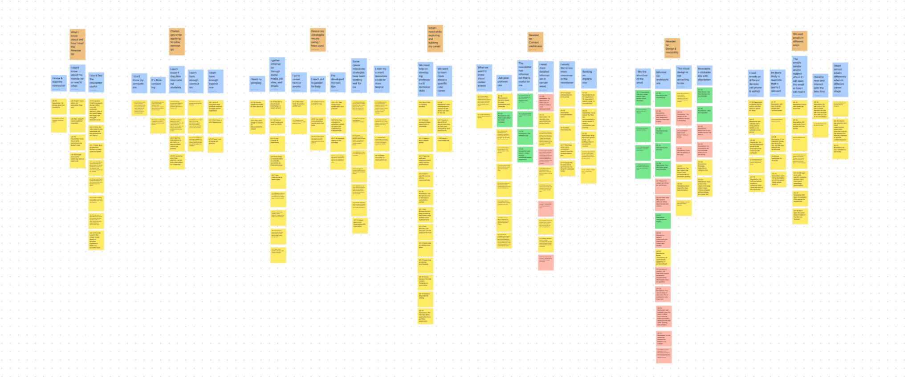
User Interviews - Affinity Map

Slide 9
User Interviews - Key findings
Students with different college degree levels or experience levels have different goals and career needs.
Different users read emails differently but share the same goal: find information that is helpful to them.
They want to know how featured internships and jobs were selected.
Both undergraduate and graduate students would like to explore career options in their field/industry.
International students want to know if the internships/jobs listed require U.S. citizenship or if they’re willing to sponsor work visa.
All the users said the current newsletter is not visually appealing to them.
Notes:
Read emails differently - on diff devices, see who sent the email, scan the biggest text first, or scan the links first

Slide 10
Problem Statement + Design Considerations
Problem Statement
How might we improve the newsletter’s readability, increase its visual interest, and provide tailored career resources for iSchool students and alumni.
Design Consideration
Currently there is only one person who’s in charge of the creation and distribution of the newsletter & drop-in career consultation.

Slide 11
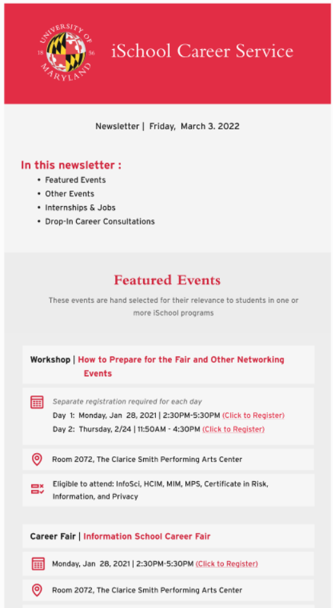
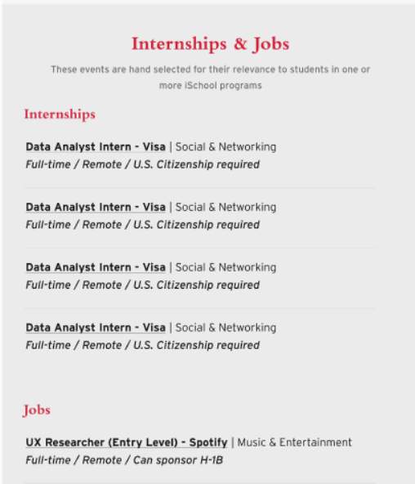
Prototype
Prototype Link
PDF Link

Slide 12
User Testing - Demographics
User # | Degree Level | Program | Domestic / International Student
1 | Undergraduate | InfoSci | Domestic
2 | Graduate | HCIM | International
3 | Graduate | HCIM | Domestic
4 | Graduate | HCIM | International

Slide 13
User Testing - Key Findings
Pros:
The “iSchool Careers Newsletter” header is eye-catching and easily identifies the source
The issue date is clearly labeled within the newsletter content at the top of the page
The reader can quickly learn what’s included in this newsletter through skimming the summary section
Cons:
Not enough color contrast between different sections
The distinction between the “Featured Events” and “Other Events” sections is unclear
Inconsistency in clickable elements

Slide 14
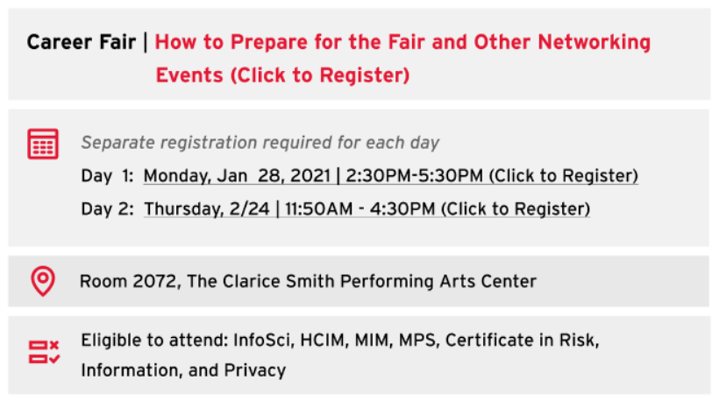
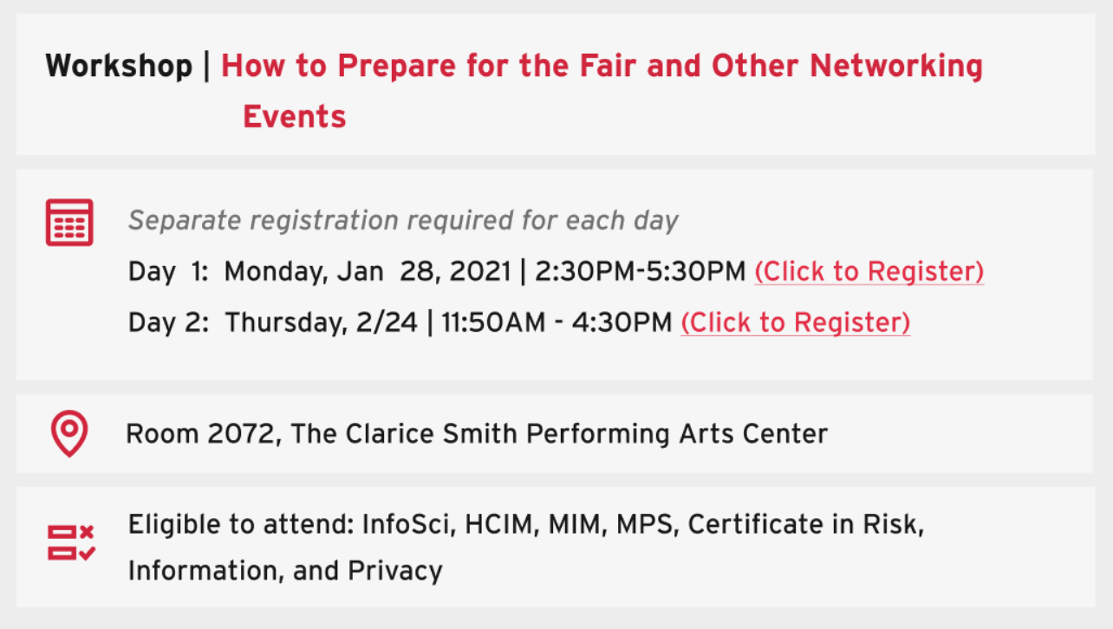
Refined Prototypes
Before Testing
After Testing

Slide 15
Limitations & Opportunities
Limitations
Sample size is not big enough
Interview participants are not representative of students from all iSchool degree programs
Only designed for desktop view
Opportunities: Design Implementation
Transform Figma design files into code using plugins
Use template generator (e.g., Mailchimp, Mailerlite)
Write custom code - HTML & CSS

Slide 16
Thank you!

Slide 17
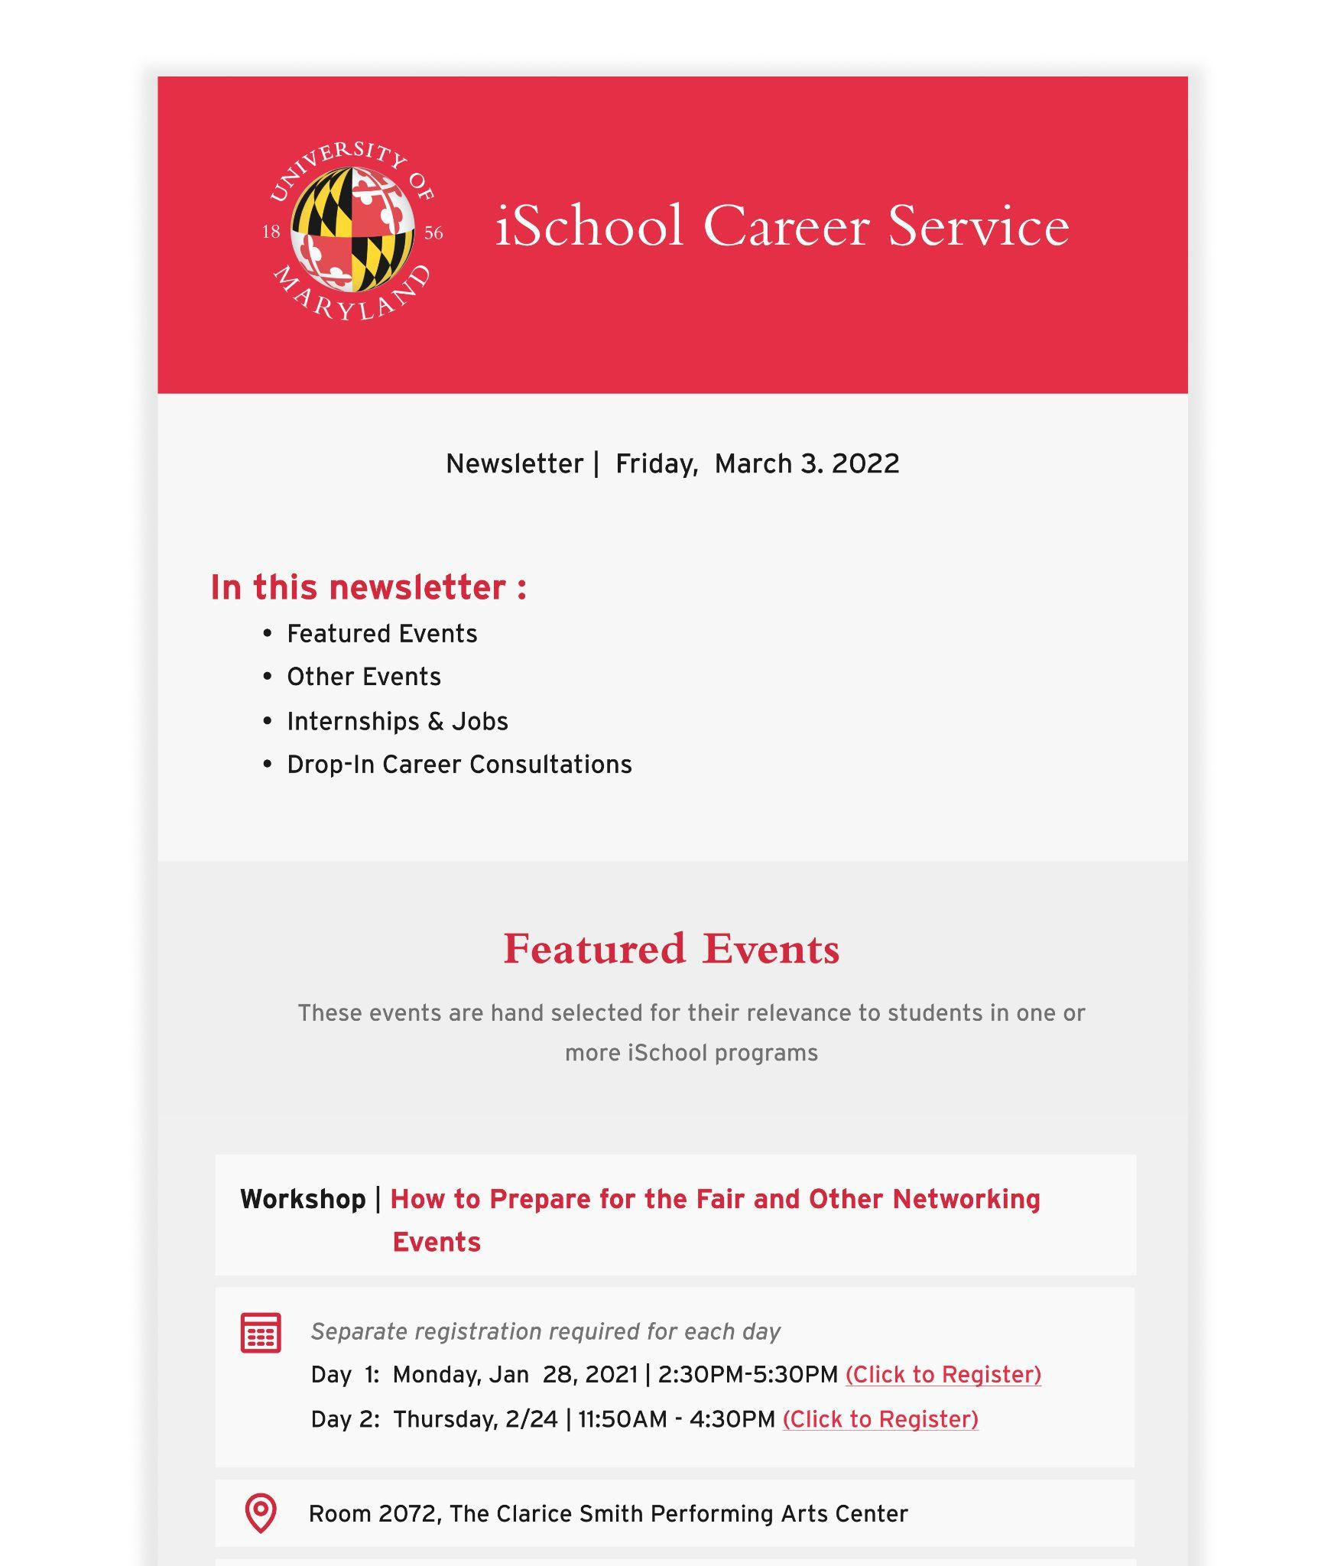
TEAM IC 22020
Yuanqi (Kinny) Chen
Zi Lin

